Slide 1


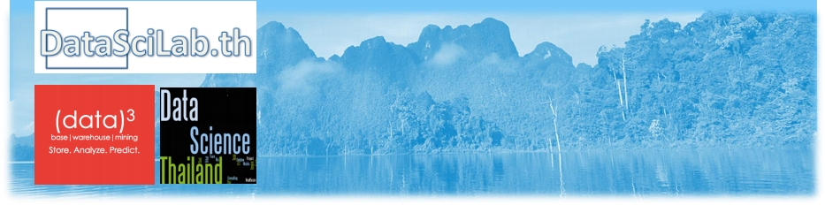
Introduction to Big Data Analytics
and
Data Science
2 เมษายน 2559
วิทยาล ย ั ศิลปะสื่อและเทคโนโลย ม ี หาว ท ิ ยาล ย ั เชียงใหม่
โกเมษ​ จันทวิมล
Komes Chandavimol
komes@datascienceth.com
1
Cheow Lan Lake, Thailand

Slide 2
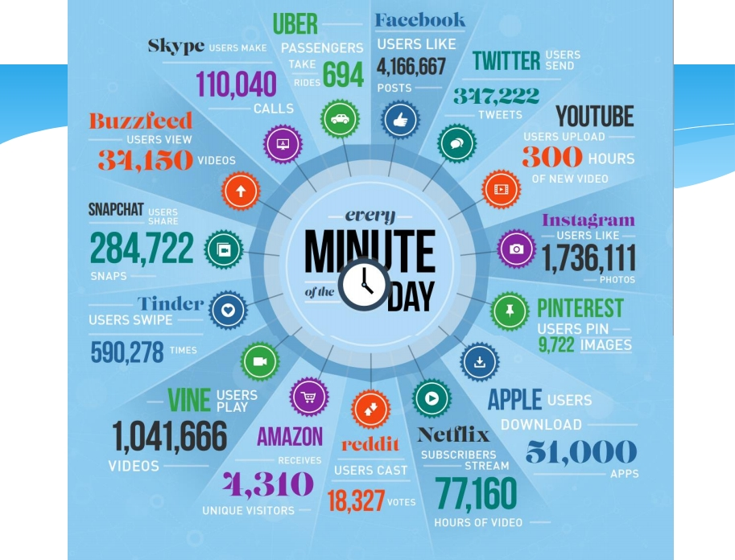
https://www.domo.com/learn/data-never-sleeps-3-0
http://www.adweek.com/prnewser/how-many-times-do-the-worlds-social-media-users-click-every-minute/117427
2

Slide 3
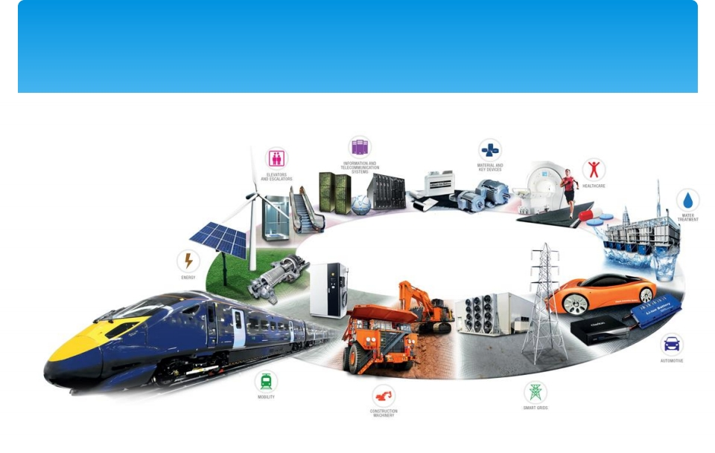
Internet of Things
http://topmanagement.com.mx/innovacion-social-y-
empresarial-objetivo-de-hitachi/
3

Slide 4
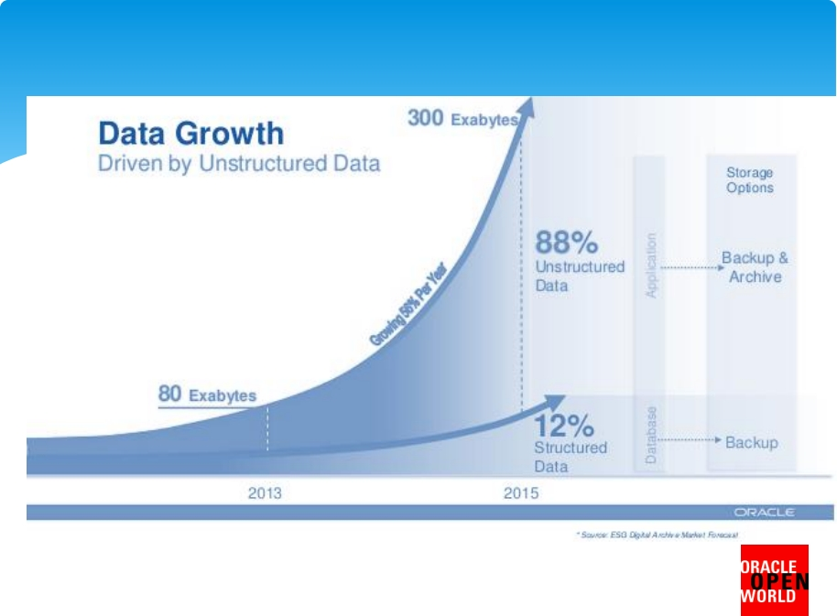
The Growth of Data
https://www.domo.com/learn/data-never-sleeps-3-0
http://www.adweek.com/prnewser/how-many-times-do-the-worlds-social-media-users-click-every-minute/117427
4

Slide 5
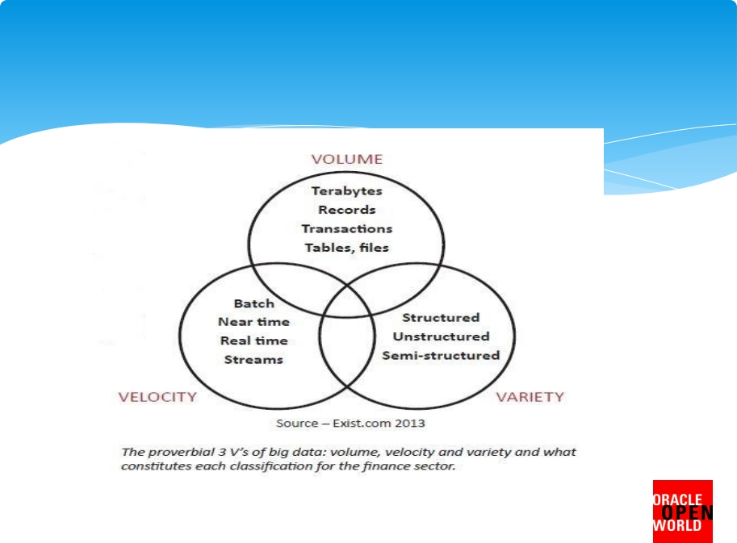
What is Big Data?
https://www.domo.com/learn/data-never-sleeps-3-0
http://www.adweek.com/prnewser/how-many-times-do-the-worlds-social-media-users-click-every-minute/117427
5

Slide 6
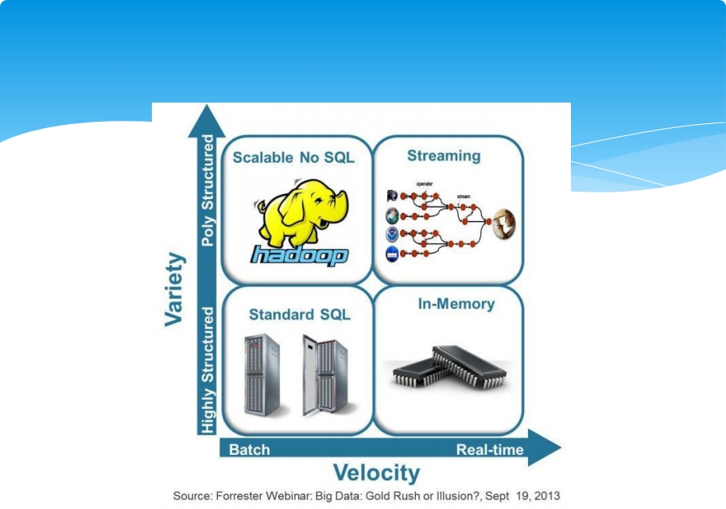
The Emergence of Big Data Tools
http://blogs.forrester.com/category/hadoop
http://solutions.forrester.com/Global/FileLib/webinars/Big_Data_-_Gold_Rush_or_Illusion.pdf
6

Slide 7
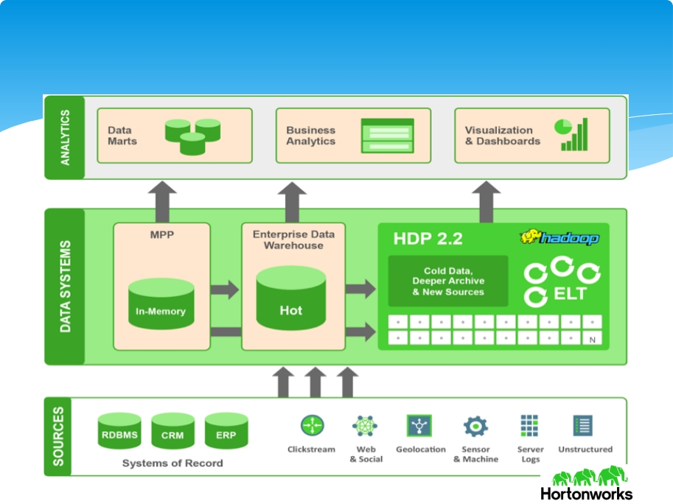
Traditional Data Management Architecture
http://hortonworks.com/blog/optimize-your-data-architecture-with-hadoop/
7

Slide 8
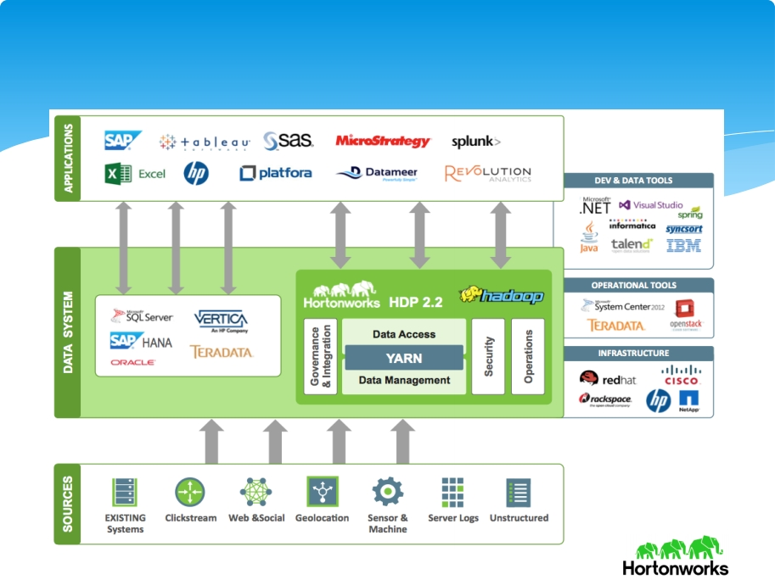
New Data Management Architecture
http://hortonworks.com/blog/optimize-your-data-architecture-with-hadoop/
8

Slide 9
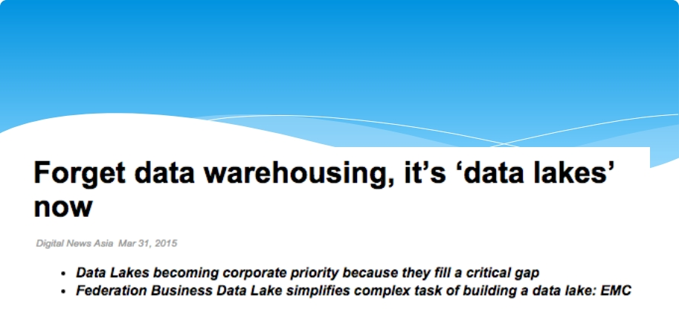

Data Lake
https://www.digitalnewsasia.com/business/forget-data-warehousing-its-data-lakes-now
9

Slide 10
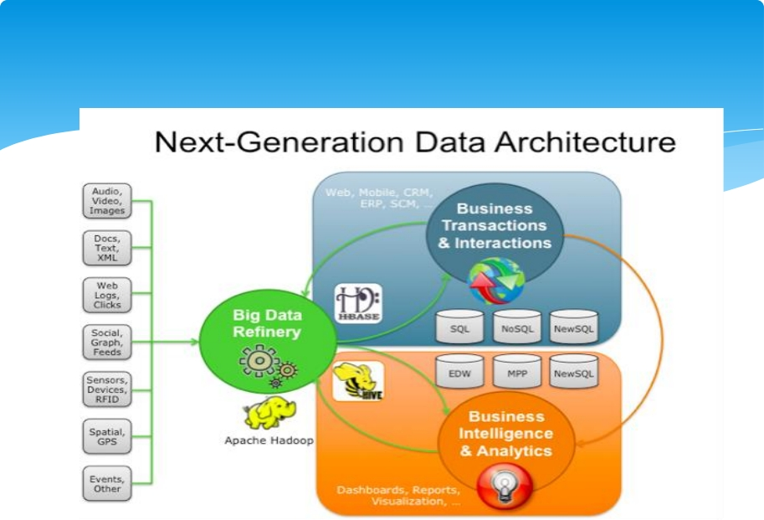
Big Data Analytics
http://hortonworks.com/blog/big-data-refinery-fuels-next-generation-data-architecture/
10

Slide 11
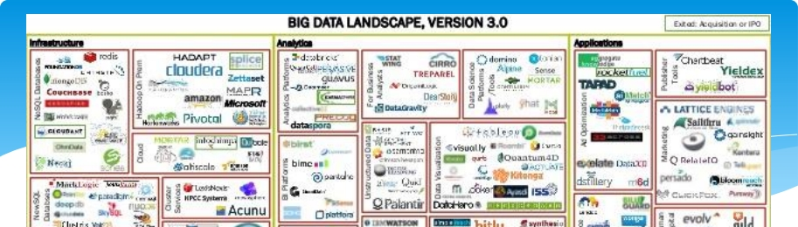
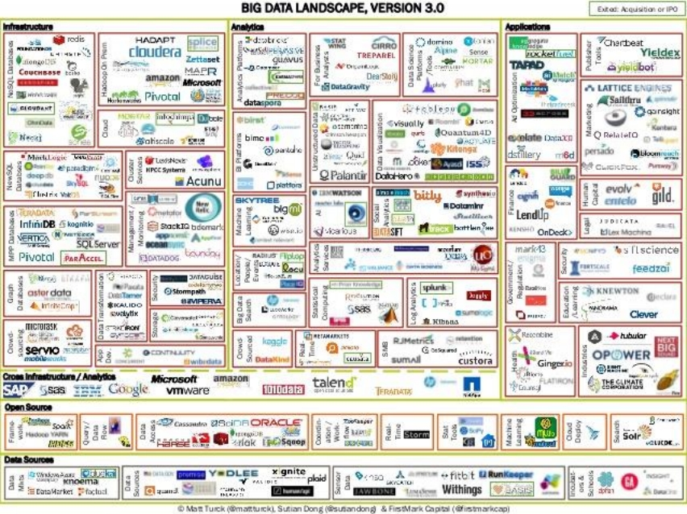
11
http://www.kdnuggets.com/2014/05/big-data-landscape-v30-
analyzed.html

Slide 12
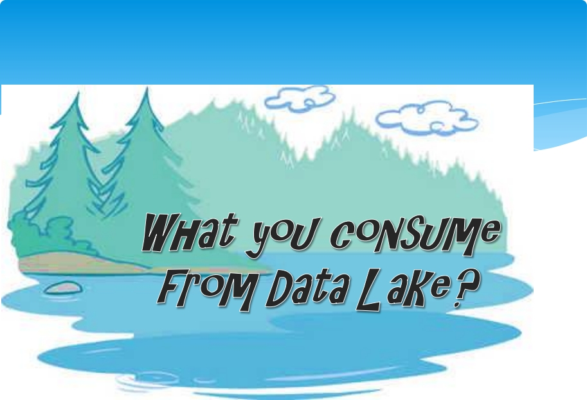

Slide 13
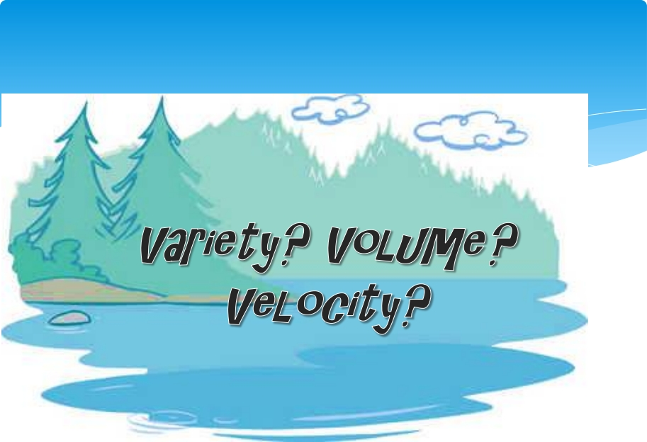

Slide 14
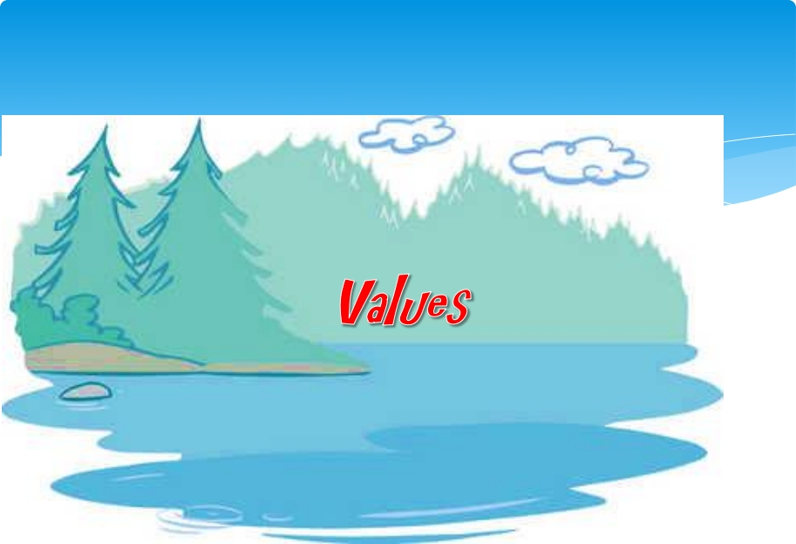

Slide 15
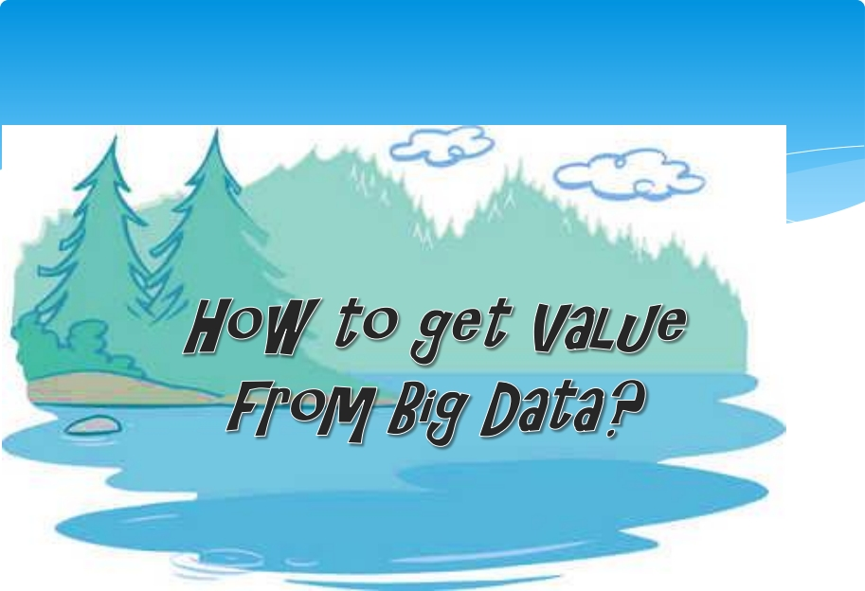

Slide 16
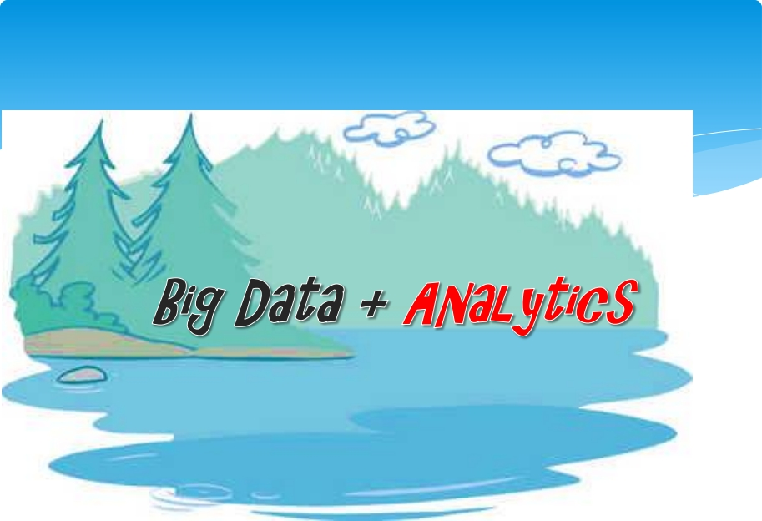

Slide 17
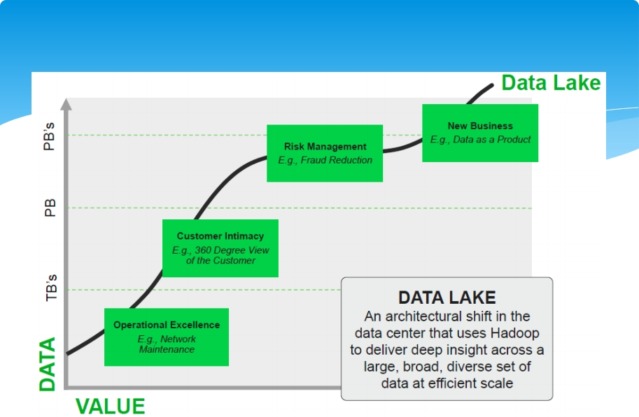
Big Data Analytics
http://dataofthings.blogspot.com/2014/04/the-bbbt-sessions-hortonworks-big-data.html
17

Slide 18
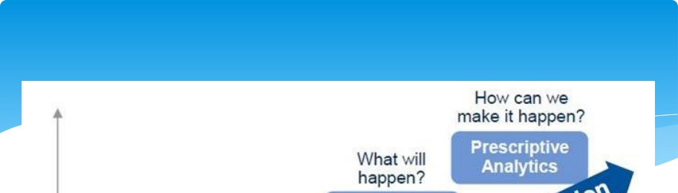
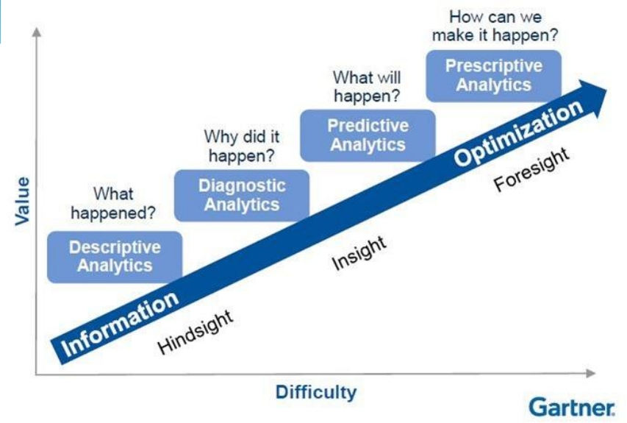
Big Data Analytics
http://www.gartner.com/it-glossary/predictive-analytics
18

Slide 19
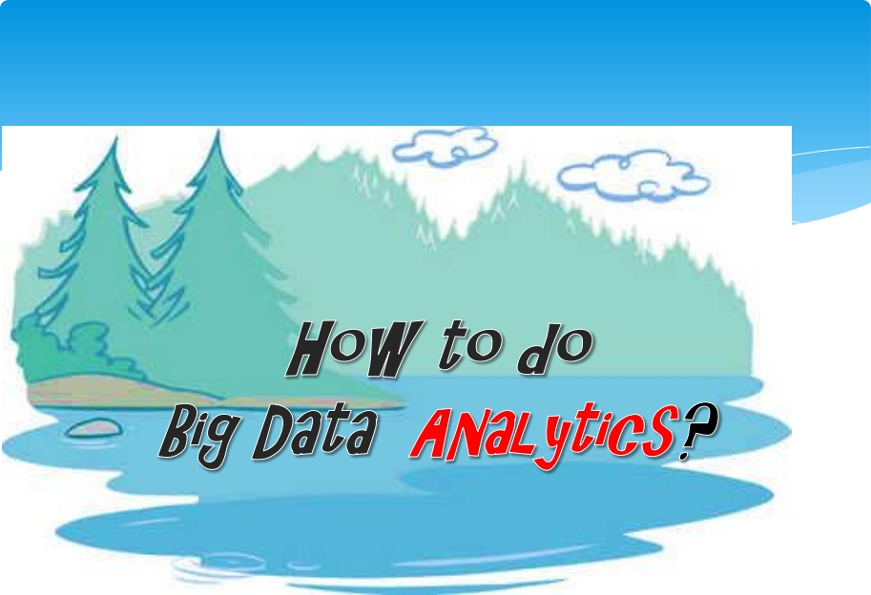

Slide 20
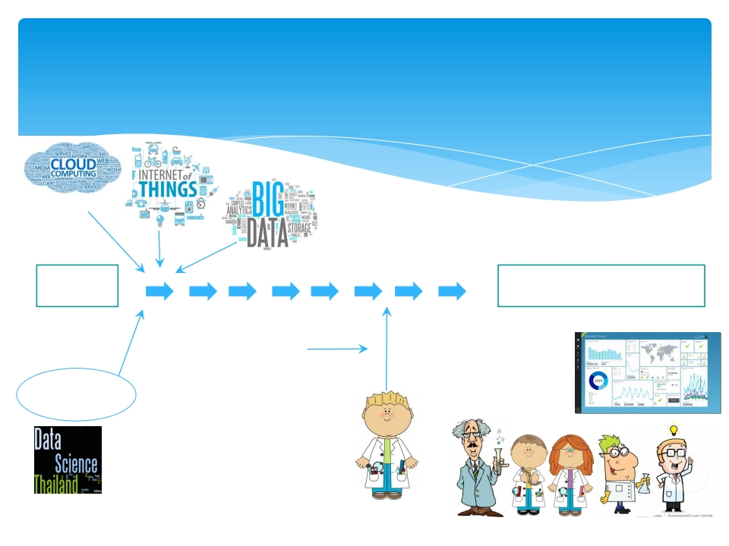
The Roles of Data Science
New Analytic Insights
(Information, knowledge, data story)
Data Product
+ Visualization
Data Science Team
Data
Datafication
Mass Analytic Tools
Machine Learning
Recommender systems
Complex Event Processing
DatascienceTh.com
Doing Data Science by O'Neil et al (2013)
Picture:http://www.clipartpanda.com/categories/scientist-clip-art
Data
Scientist

Slide 21

Workshop
Data Visualization
21

Slide 22
Workshop
What would be good data Visualization designer?
22

